Slide 1
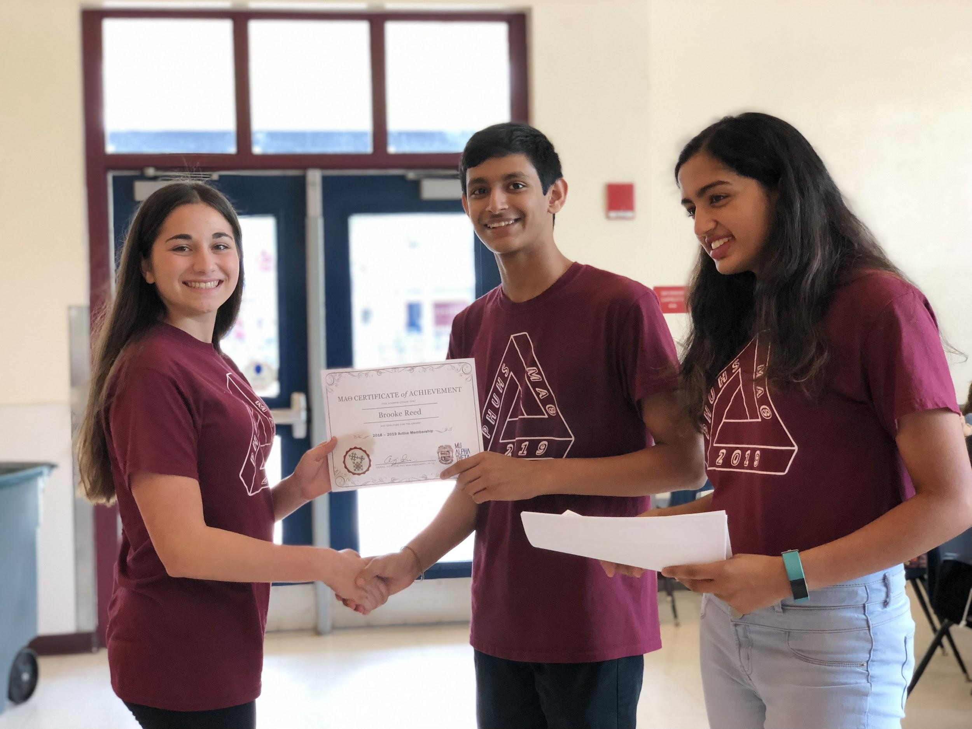
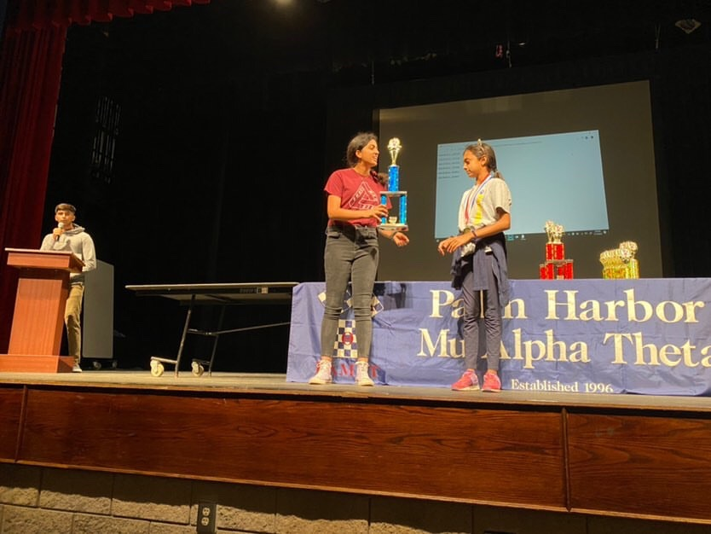
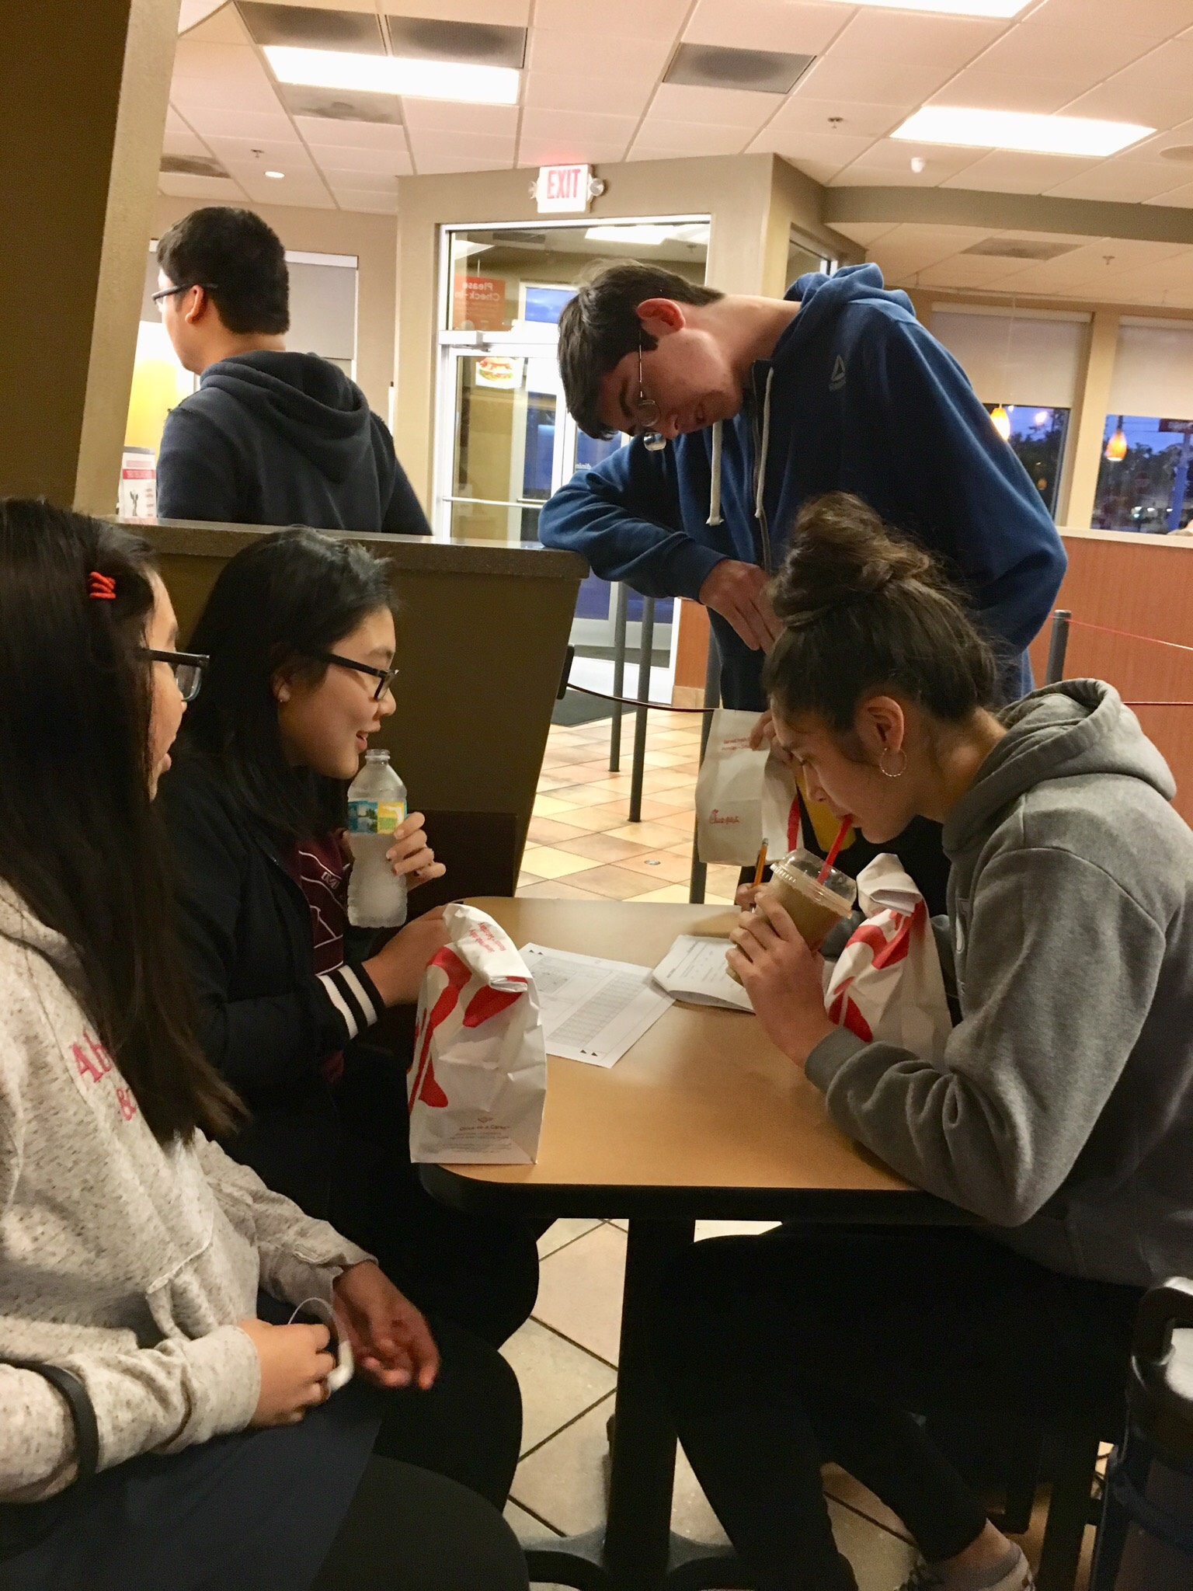
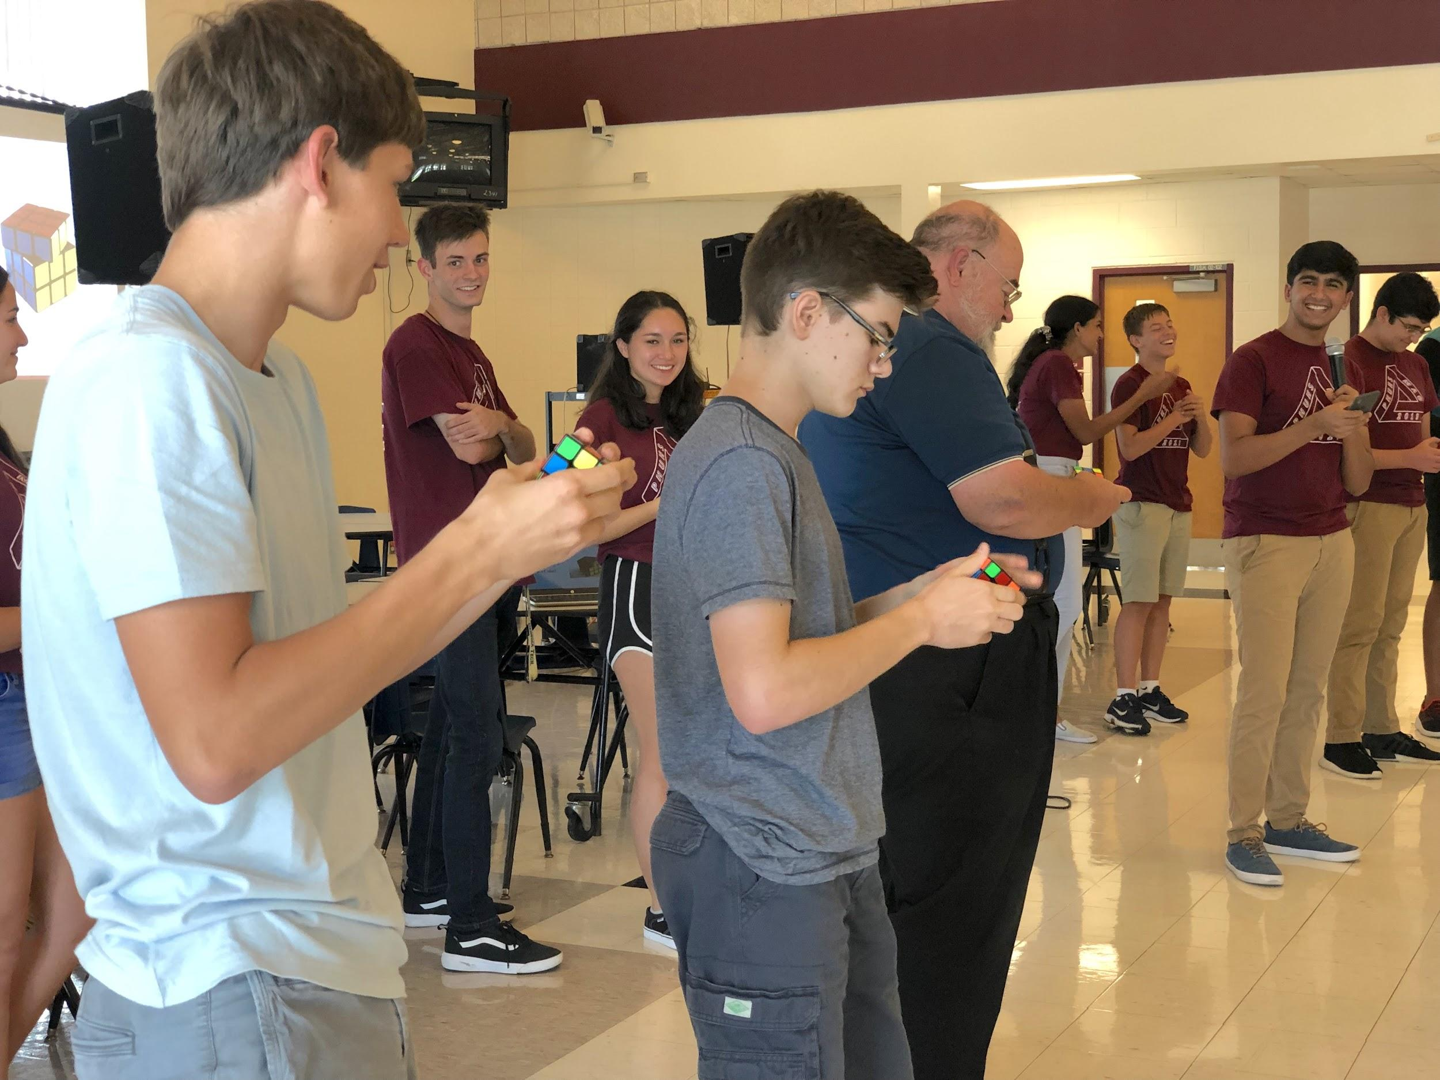
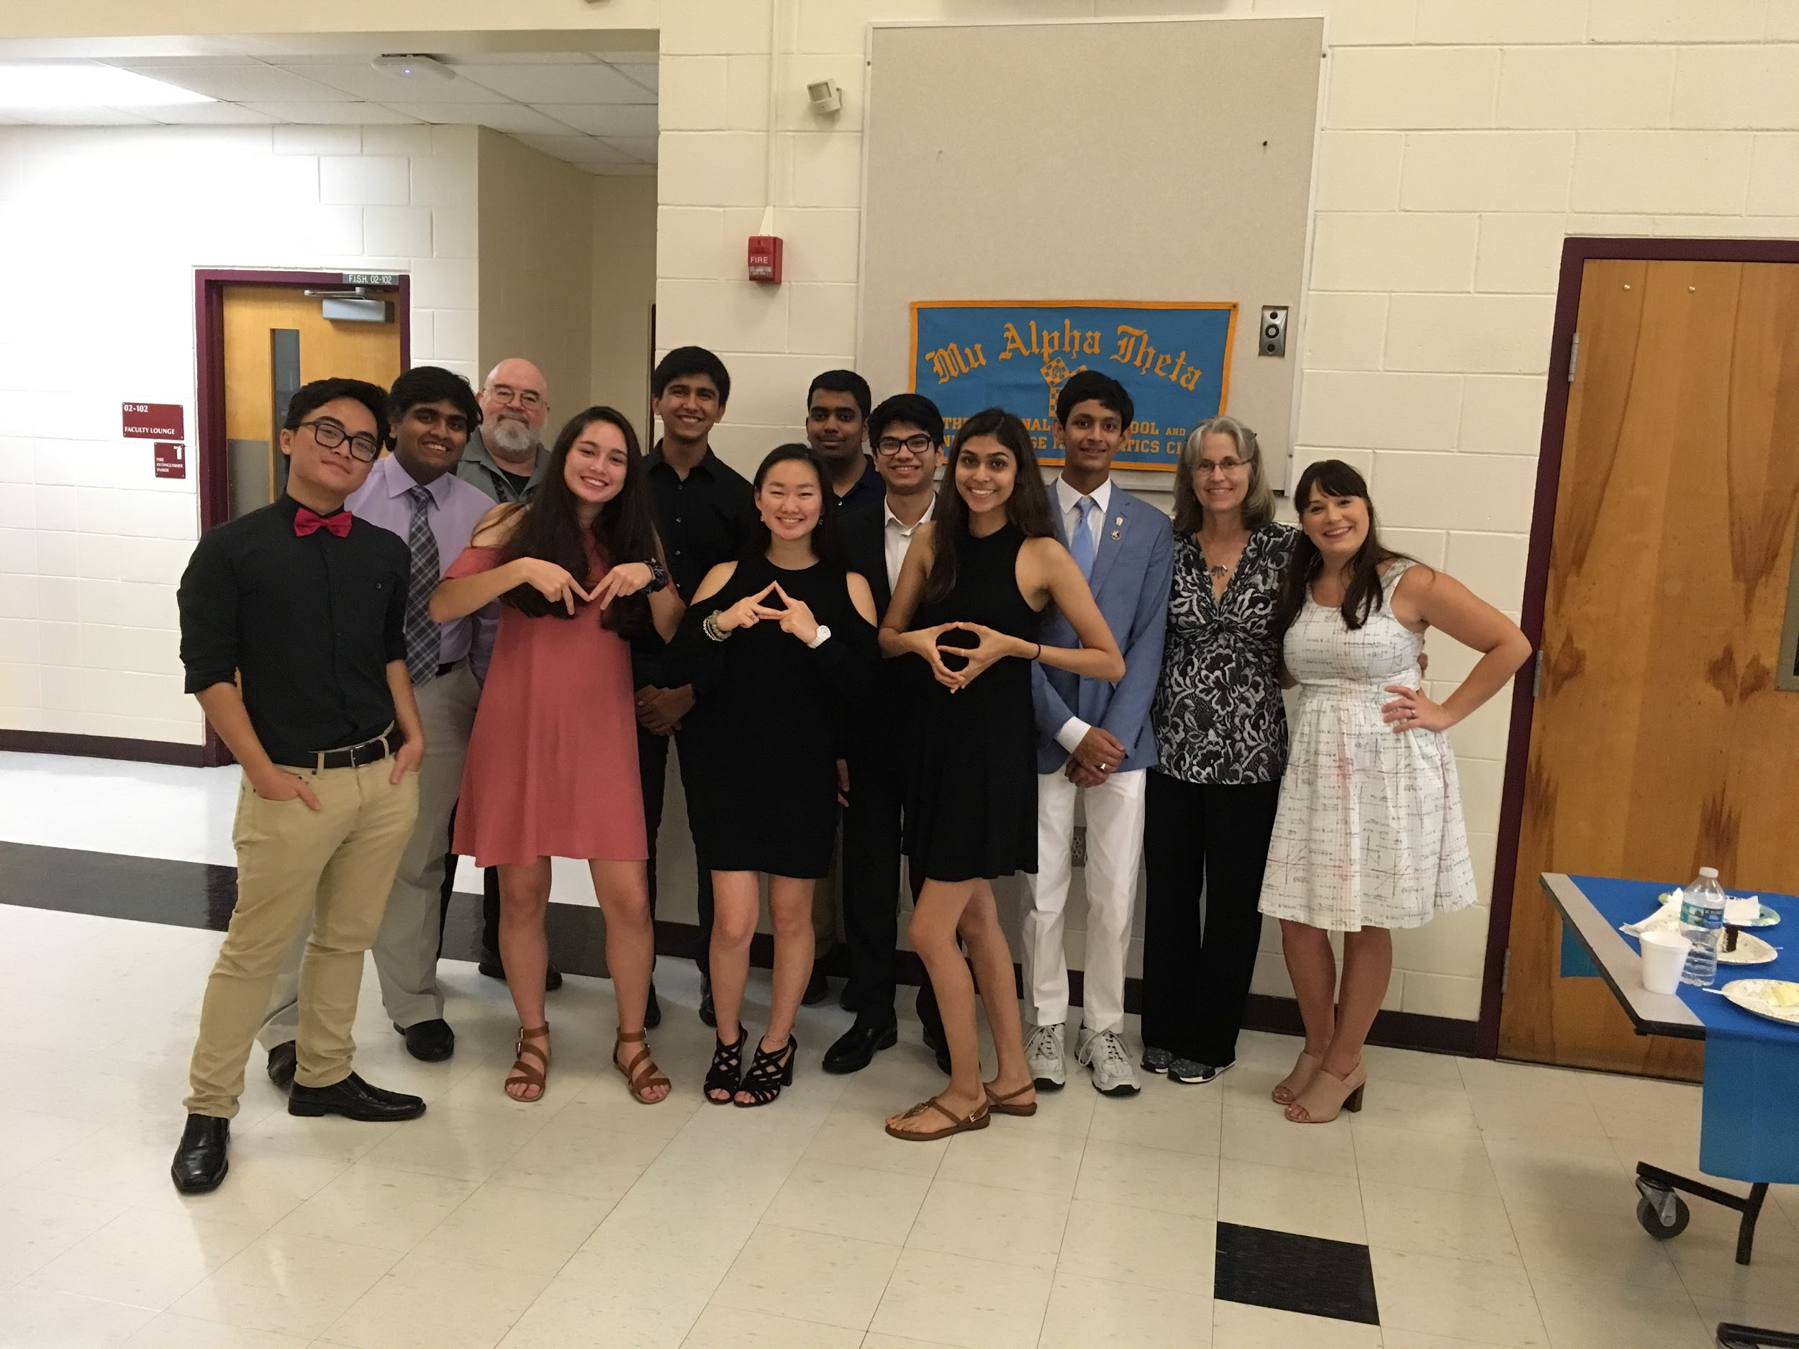
MU ALPHA THETA 2020-2021

Slide 2
WHO WE ARE
Sponsor - Mrs. Mandurano
President: Jennifer Lawrence
Vice Presidents: Brooke Reed & Jack Smith
Secretary: Katie Quach
Treasurer: Vaarun Ramanathan
Historian: Amadeo Hoxha
Technology Coordinators: Miles Gordon & Melinda Liu
Sergeant-at-Arms: Kyle Cooper & Janet Liu

Slide 3
WHY SHOULD YOU JOIN?
Honor Society
CAS/Bright Future Hours
Leadership Opportunity
Competition
Math!!

Slide 5
CLUB LAYOUT
Practices weekly on Thursday’s (1st on 10/1)
6 FAMAT Competitions throughout the school year + In-School competitions
Mighty Mu
Scrapbooking

Slide 6
COMPETITIONS
In-School
Oct 28 - Nov 4 - Fall Interschool
Dec 2 - Dostal Nunn
Feb 4* - AMC A
Feb 10* - AMC B
Log 1 - TBD
FAMAT
Jan 16 - Buchholz
Jan 30 - King HS
Feb 13 - TBD
Feb 27 - Dunbar
March 6 - Wharton
March 20 - TBD
April 16-18 - Orlando State Convention

Slide 7
T-SHIRTS & SCRAP
BOOKING
Friday after school (1st meeting 10/2)
Mr. Macfarlane’s room (4-205) / virtually for 1st Semester
Club T-shirts
Front & Back
1 point per quality submission (max of 3)
Must be school-appropriate and (preferably) math-related

Slide 8
ACTIVE MEMBERSHIP
35 points for active membership (required for letter positions)
45 points for active+ membership (required to run for board)
Points from practices, competitions, scrapbooking, practice tests (2)
Tutoring requirement waived 1st semester
Points sheet on website

Slide 9
DUES & REGISTRATION
10/5 - 10/9; $25 + paperwork
10/12 - 10/16; $35 + paperwork (late fee)
Application and payment through RevTrack on school website.

Slide 10
COMMUNICATION
Remind: text @phuhsmao20 to 81010
Teams: uqe0px4
Website: http://phuhsmao.weebly.com/

Slide 11
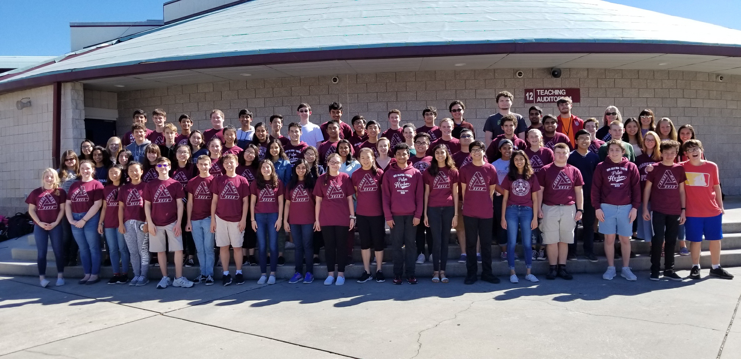
Questions?
THANK YOU FOR JOINING!

